Slide 1

Zephyr Workshop - Sensor Subsystem
A comprehensive introduction to Zephyr's sensor abstraction layer, featuring practical implementation with the TMP102 temperature sensor.

Slide 2
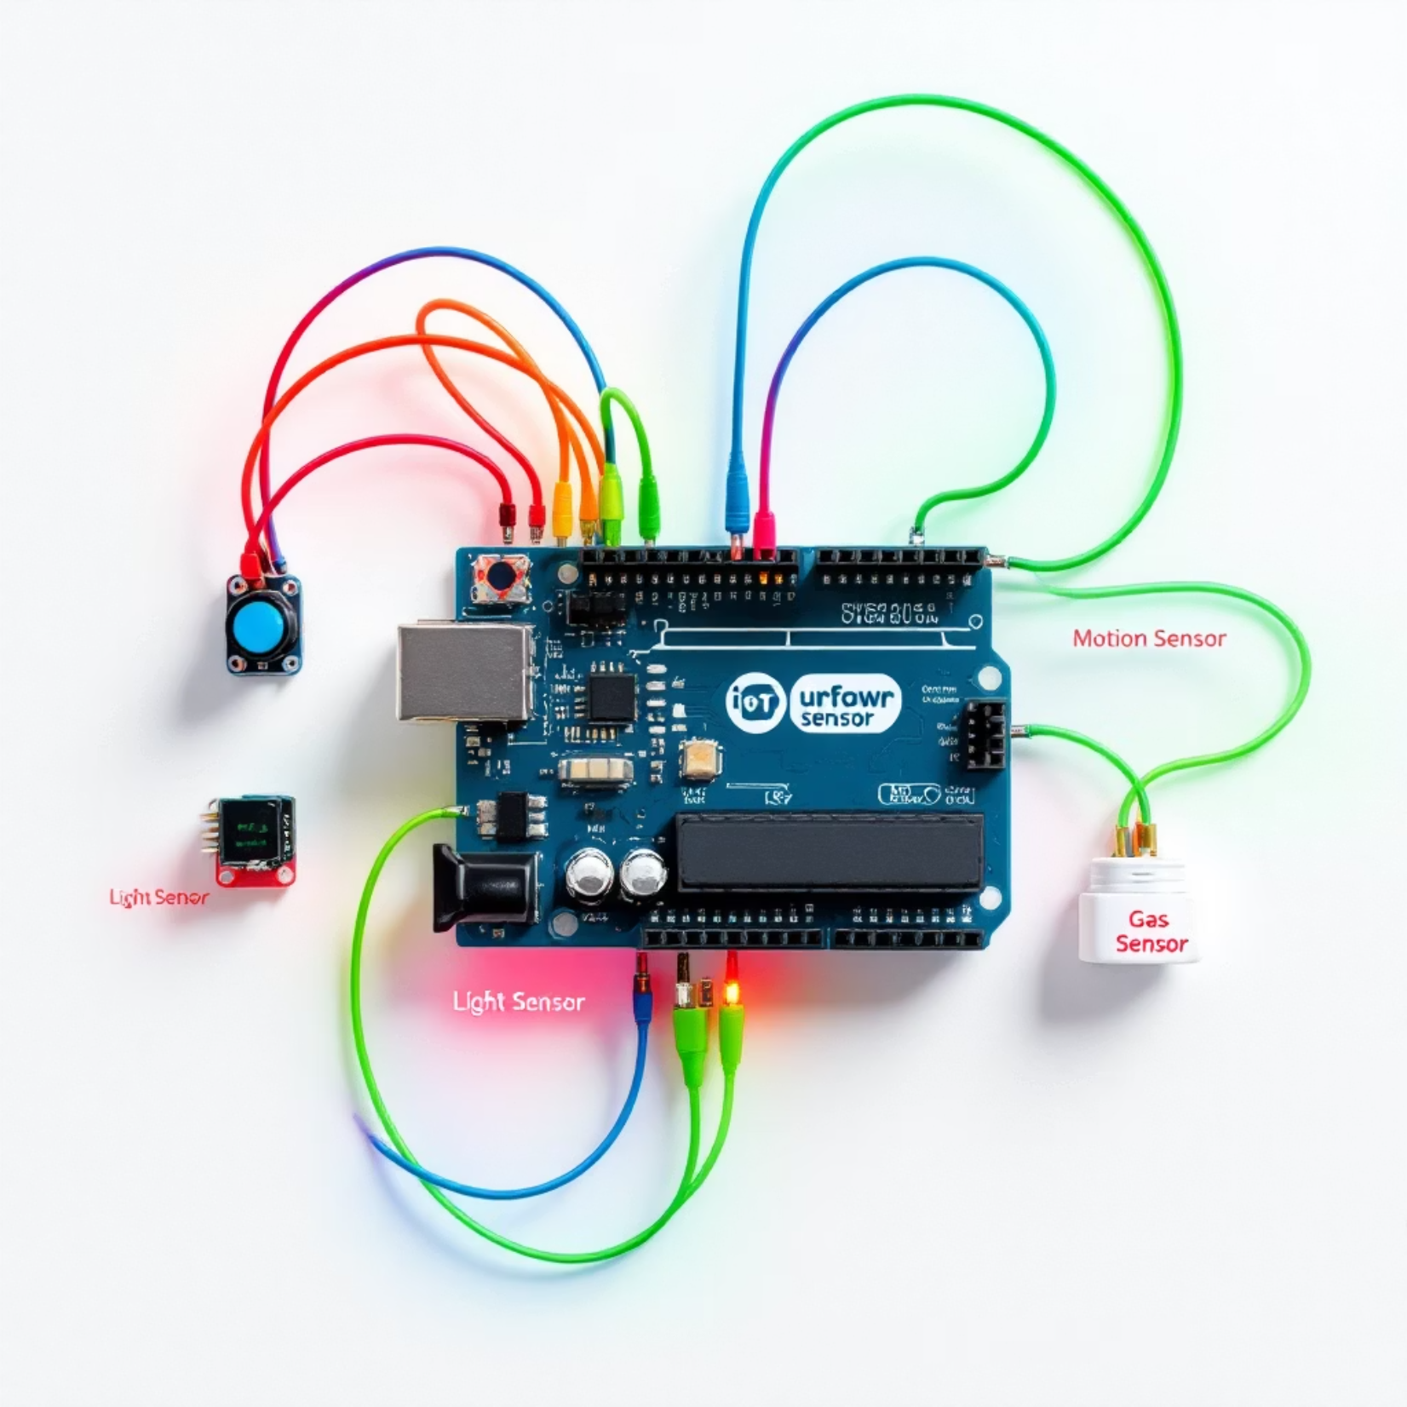
What is the Sensor Subsystem?
The Sensor Subsystem in Zephyr RTOS provides:
A generic interface to interact with various sensor hardware regardless of manufacturer
Portable application code that works across different sensor implementations
Unified API for accelerometers, gyroscopes, temperature sensors, and many more

Slide 3



Why Abstraction Matters
Vendor-Agnostic
Simplified Architecture
Consistent Pattern
Switch between sensor hardware without rewriting application logic, enabling easy hardware upgrades
Reduces complexity in the application layer by hiding implementation details
Universal workflow: fetch → get channel → process data
This abstraction is particularly valuable in embedded systems where hardware configurations change frequently during development.

Slide 4





Sensor Driver API Overview
sensor_sample_fetch()
Initiates a sensor reading operation, gathering fresh data from the hardware
sensor_channel_get()
Retrieves specific channel values from the most recent fetch operation
sensor_attr_set()
Optional: Configure sensor attributes like scale, frequency, and sensitivity
sensor_trigger_set()
Registers interrupt handlers or polling callbacks for sensor events

Slide 5
Zephyr Sensor Channels
Zephyr defines standard channel types that represent different sensor measurements:
SENSOR_CHAN_ACCEL_XYZ
SENSOR_CHAN_GYRO_XYZ
SENSOR_CHAN_TEMP
3-axis angular velocity, typically in rad/s
Temperature readings in degrees Celsius
3-axis acceleration data, typically in m/s²
SENSOR_CHAN_LIGHT
SENSOR_CHAN_PRESS
Ambient light levels, often in lux
Atmospheric pressure, typically in kilopascals
Each channel type corresponds to a specific type of physical measurement that can be retrieved from compatible sensors.

Slide 6
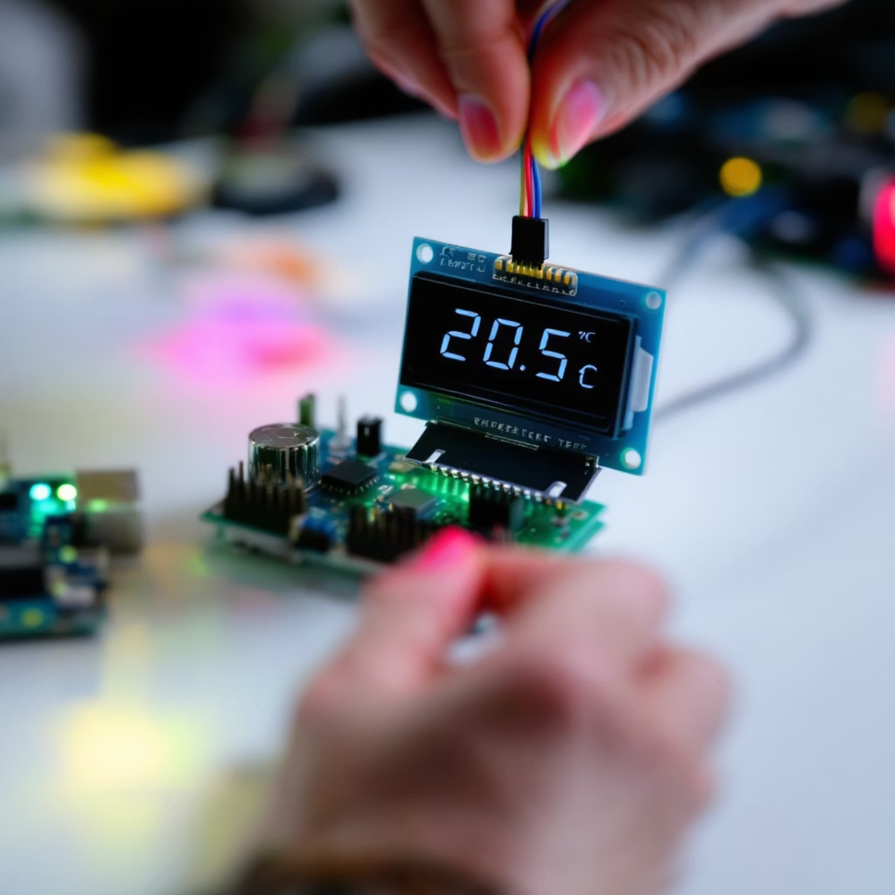
Sensor Value Struct
struct sensor_value {
int val1; /* integer part */
int val2; /* fractional part in micro units */
};
For example, to represent 20.500000°C:
val1 = 20 (integer part)
val2 = 500000 (fractional part)
Typical usage in code:
printf("%d.%06d", val.val1, val.val2);
This representation allows for precise readings while avoiding floating-point operations, which can be expensive on embedded systems.

Slide 7

TMP112 Implementation of Sensor API
The TMP112 temperature sensor demonstrates how to implement the Zephyr sensor API:
Extends the generic sensor driver interface
Implements required callbacks for initialization
Provides channel-specific data retrieval
Translates raw sensor values to standard format
Key files to examine:
include/zephyr/drivers/sensor.h - API definition
drivers/sensor/tmp112/tmp112.c - Implementation example

Slide 8
What is Required in DeviceTree?
1
Sensor Description
2
Bus Connection
3
Required Properties
Sensor must be properly described in the board's .dts file or in an application-specific overlay file
Specify the connection method (typically I2C or SPI) with correct bus parameters
Include the "compatible" string to match driver, "reg" for address, and any GPIO interrupt connections

Slide 9

Sample Demo: TMP102 Setup
To prepare the TMP102 demo:
Navigate to the sample directory: samples/sensor/tmp112
Create an app.overlay file for your board
* Update the arduino_i2c node from nrf52dk_nrf52832.dts
* Add the TMP102 sensor node with appropriate address
Hint: TMP102 is similar to TMP112 but uses a different I2C slave address. Check frdm_k64f.overlay for reference.

Slide 10
Sample Demo: Building and Testing
Build the Sample
Use the west build command to compile the sample for your target board:
west build -p always -b nrf52dk/nrf52832 samples/sensor/tmp112
Connect Hardware
Wire the TMP102 sensor to the development board according to the pinout documentation.
Flash and Test
Upload the firmware and verify operation:
west flash
Monitor the serial output to confirm temperature readings.

Slide 11
Shell Integration
Zephyr allows registering CLI commands via shell subsystem
comment out the do_main function
add to prj.conf
CONFIG_SHELL=y CONFIG_SENSOR_SHELL=y
rebuild and flash
run ‘sensor get tmp112@48 ambient_temp’

Slide 12
zephyr abstraction
change zephyr board to nrf52833/40 or stm32wl
rebuild and run

